Slide 1


CMR TECHNICAL CAMPUS UGC (Autonomous) Kandlakoya, Medchal Road, Hyd-501 401 Department of Computer Science and Engineering
Major Project Review
MALICIOUS URL DETECTION BASED ON MACHINE LEARNING
BATCH NO-15
Project Guide:
Ms Raheem Unnisa
Assistant Professor, CSE Department
Project Coordinator:
Prof K. Narasimha Rao
Associate Professor, CSE Department
Presented by:
207R1A0576 : Edula Saketha
207R1A0578 : Gampa Bhavitha
207R1A0566 : Boddu Bharath Kumar

Slide 2
CONTENTS
Introduction
Abstract
Existing system
Disadvantages of existing system
Proposed system
Advantages of proposed system
Hardware and software requirements
Novelty
Architecture
Modules
UML Diagrams
Conclusion

Slide 3
ABSTRACT
Currently, the risk of network information insecurity is increasing rapidly in number and level of danger. The methods mostly used by hackers today is to attack end-toend technology and exploit human vulnerabilities.
These techniques include social engineering, phishing, pharming, etc. One of the steps in conducting these attacks is to deceive users with malicious Uniform Resource Locators (URLs). As a results, malicious URL detection is of great interest nowadays.
There have been several scientific studies showing a number of methods to detect malicious URLs based on machine learning and deep learning techniques. In this project, we propose a malicious URL detection method using machine learning techniques based on our proposed URL behaviors and attributes.

Slide 4
EXISTING SYSTEM
Studies on malicious URL detection using the signature sets had been investigated and applied long time ago. Most of these studies often use lists of known malicious URLs. Whenever a new URL is accessed, a database query is executed.
If the URL is blacklisted, it is considered as malicious, and then, a warning will be generated otherwise URLs will be considered as safe
There are three types of machine learning algorithms that can be applied on malicious URL detection methods, including supervised learning, unsupervised learning, and semi-supervised learning .The detection methods are based on URL behaviors.
The number of malicious URL systems based on machine learning algorithms have been investigated.

Slide 5
DISADVANTAGES OF EXISTING SYSTEM
The system is not implemented Machine Learning Algorithm Selection.
The system is not implemented URL Attribute Extraction and Selection.

Slide 6
PROPOSED SYSTEM
In the proposed system, machine learning algorithms are used to classify URLs based on the features and behaviors of URLs.
The features are extracted from static and dynamic behaviors of URLs and are new to the literature.
Those newly proposed features are the main contribution of the research. Machine learning algorithms are a part of the whole malicious URL detection system.
Two supervised machine learning algorithms are used, Support vector machine (SVM) and Random forest (RF).

Slide 7
ADVANTAGES OF PROPOSED SYSTEM
The proposed algorithms are suitable to utilized the usefulness of our new features selected for malicious URL detection.
In the proposed work, SVM and RF are selected as an example to illustrate the good performance of the whole detection system, and are not our main focus. Readers are encouraged to implement some other algorithms such as Naïve Bayes, Decision trees, k-nearest neighbors, neural networks, etc.

Slide 8
HARDWARE REQUIREMENTS
Processor : Pentium –IV
RAM : 4 GB (min)
Hard Disk : 20 GB
Key Board : Standard Windows Keyboard
Mouse : Two or Three Button Mouse
Monitor : SVGA

Slide 9
SOFTWARE REQUIREMENTS
Operating system : Windows 7 Ultimate.
Coding Language : Python.
Front-End : Python.
Back-End : Django-ORM
Designing : Html, css, java script.
Data Base : MySQL (WAMP Server).

Slide 10
NOVELTY OF PROJECT
The Novelty of Malicious URL Detection based on Machine Learning, the project's novelty lies in its multifaceted approach to push the boundaries of traditional methodologies. To achieve groundbreaking results, the project delves into the integration of state-of-the-art deep learning architectures, exploring the transformative capabilities of models like Transformers and BERT for sequential data analysis.
Additionally, the incorporation of explainable AI (XAI) ensures transparency in decision-making, bolstering user and security professional trust. This project pioneers the use of adversarial machine learning techniques to enhance the model's resilience against evasion attempts, marking a significant step towards robust security frameworks.
Furthermore, the inclusion of behavioral analysis introduces a dynamic dimension, considering user interactions and patterns of behavior to detect anomalies beyond static features. By embracing transfer learning, the project taps into the collective knowledge of related domains, such as phishing detection and malware analysis, to elevate the model's performance.

Slide 11
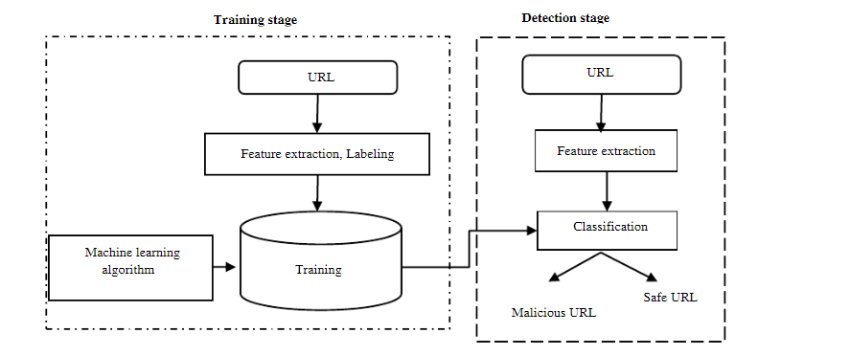
ARCHITECTURE

Slide 12
MODULES
Data Collection and Preprocessing:
Data Gathering: Collect a diverse dataset of URLs, including both benign and malicious examples.
Data Labeling: Manually or automatically label the URLs in the dataset as either malicious or benign.
Data Cleaning: Remove irrelevant or redundant information from the URLs and standardize the format for consistency.
Feature Extraction:
URL Parsing: Extract relevant features from the URLs, such as domain, path, length, and structure.
Tokenization: Break down the URL into tokens to analyze the components separately.
N-grams: Utilize n-grams to capture sequential patterns within the URL.

Slide 13
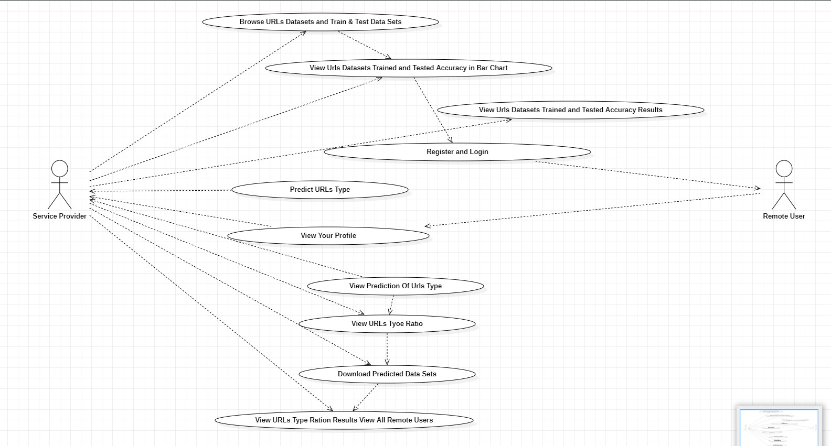
USE CASE DIAGRAM

Slide 14
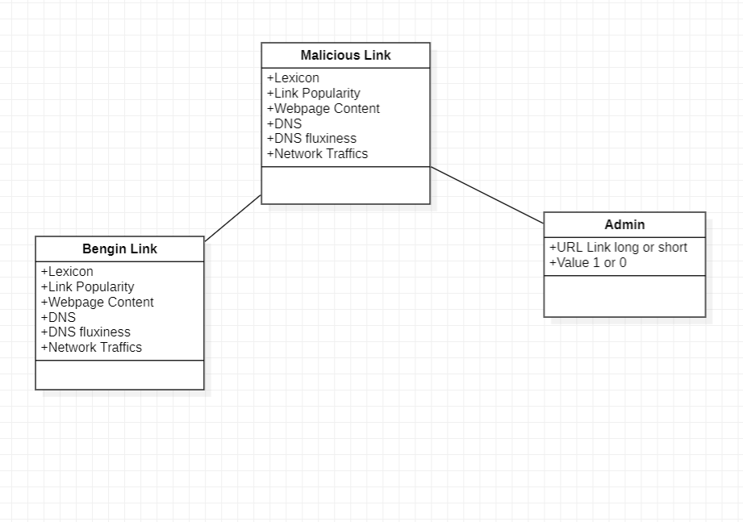
CLASS DIAGRAM

Slide 15
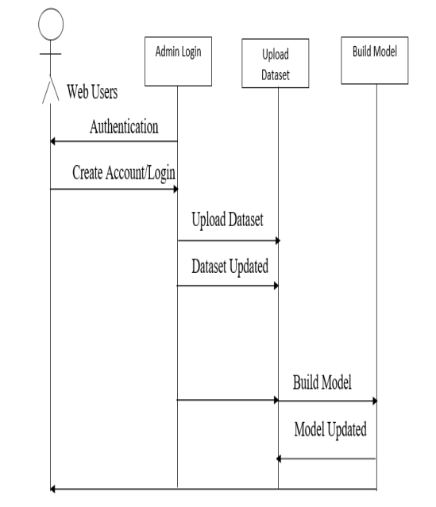
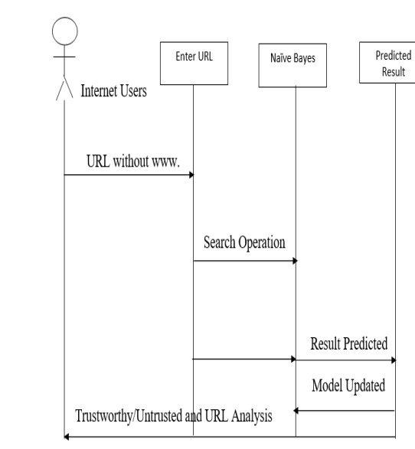
SEQUENCE DIAGRAM

Slide 16
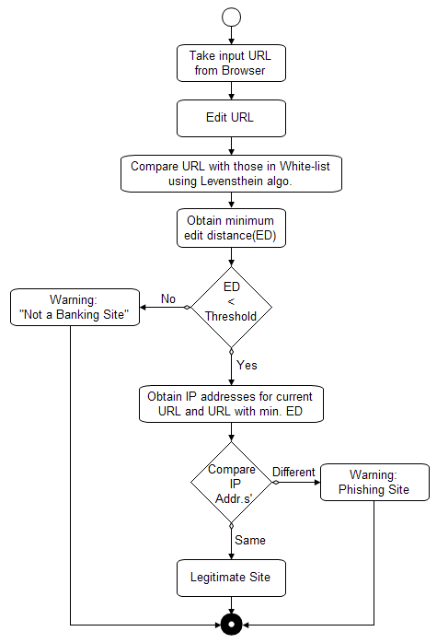
ACTIVITY DIAGRAM

Slide 17
SAMPLE CODE
from django.db.models import Count
from django.db.models import Q
from django.shortcuts import render, redirect, get_object_or_404
import pandas as pd
from sklearn.feature_extraction.text import CountVectorizer
from sklearn.metrics import accuracy_score, confusion_matrix, classification_report
from sklearn.metrics import accuracy_score
from sklearn.tree import DecisionTreeClassifier
from sklearn.ensemble import VotingClassifier
# Create your views here.
from Remote_User.models import ClientRegister_Model,malicious_url_detection,detection_ratio,detection_accuracy
def login(request):
if request.method == "POST" and 'submit1' in request.POST:
username = request.POST.get('username')
password = request.POST.get('password')
try:
enter = ClientRegister_Model.objects.get(username=username,password=password)
request.session["userid"] = enter.id
return redirect('ViewYourProfile')
except:
pass
return render(request,'RUser/login.html')

Slide 18
def index(request):
return render(request, 'RUser/index.html')
def Add_DataSet_Details(request):
return render(request, 'RUser/Add_DataSet_Details.html', {"excel_data": ''})
def Register1(request):
if request.method == "POST":
username = request.POST.get('username')
email = request.POST.get('email')
password = request.POST.get('password')
phoneno = request.POST.get('phoneno')
country = request.POST.get('country')
state = request.POST.get('state')
city = request.POST.get('city')
address = request.POST.get('address')
gender = request.POST.get('gender')
ClientRegister_Model.objects.create(username=username, email=email, password=password, phoneno=phoneno,
country=country, state=state, city=city,address=address,gender=gender)
obj = "Registered Successfully"
return render(request, 'RUser/Register1.html',{'object':obj})
else:
return render(request,'RUser/Register1.html')
def ViewYourProfile(request):
userid = request.session['userid']
obj = ClientRegister_Model.objects.get(id= userid)
return render(request,'RUser/ViewYourProfile.html',{'object':obj})

Slide 19
def Predict_Drug_Response(request):
if request.method == "POST":
if request.method == "POST":
urlname= request.POST.get('textarea')
df = pd.read_csv('Malicious_URLs.csv', encoding='latin-1')
mapping = {'good': 0, 'bad': 1}
df['Results'] = df['Class'].map(mapping)
cv = CountVectorizer(lowercase=False, strip_accents='unicode', ngram_range=(1, 1))
X = df['URLs']
y = df['Results']
print("URLs")
print(X)
print("Results")
print(y)
X = cv.fit_transform(X)
models = []
from sklearn.model_selection import train_test_split
X_train, X_test, y_train, y_test = train_test_split(X, y, test_size=0.20)
X_train.shape, X_test.shape, y_train.shape
print("Naive Bayes")
from sklearn.naive_bayes import MultinomialNB
NB = MultinomialNB()
NB.fit(X_train, y_train)
predict_nb = NB.predict(X_test)
naivebayes = accuracy_score(y_test, predict_nb) * 100
print("ACCURACY")
print(naivebayes)
print("CLASSIFICATION REPORT")

Slide 20
print(classification_report(y_test, predict_nb))
print("CONFUSION MATRIX")
print(confusion_matrix(y_test, predict_nb))
models.append(('naive_bayes', NB))
# SVM Model
print("SVM")
from sklearn import svm
lin_clf = svm.LinearSVC()
lin_clf.fit(X_train, y_train)
predict_svm = lin_clf.predict(X_test)
svm_acc = accuracy_score(y_test, predict_svm) * 100
print("ACCURACY")
print(svm_acc)
print("CLASSIFICATION REPORT")
print(classification_report(y_test, predict_svm))
print("CONFUSION MATRIX")
print(confusion_matrix(y_test, predict_svm))
models.append(('svm', lin_clf))
print("Logistic Regression")
from sklearn.linear_model import LogisticRegression
reg = LogisticRegression(random_state=0, solver='lbfgs').fit(X_train, y_train)
y_pred = reg.predict(X_test)
print("ACCURACY")
print(accuracy_score(y_test, y_pred) * 100)
print("CLASSIFICATION REPORT")
print(classification_report(y_test, y_pred))
print("CONFUSION MATRIX")
print(confusion_matrix(y_test, y_pred))
models.append(('logistic', reg))

Slide 21
print("Decision Tree Classifier")
dtc = DecisionTreeClassifier()
dtc.fit(X_train, y_train)
dtcpredict = dtc.predict(X_test)
print("ACCURACY")
print(accuracy_score(y_test, dtcpredict) * 100)
print("CLASSIFICATION REPORT")
print(classification_report(y_test, dtcpredict))
print("CONFUSION MATRIX")
print(confusion_matrix(y_test, dtcpredict))
models.append(('DecisionTreeClassifier', dtc))
classifier = VotingClassifier(models)
classifier.fit(X_train, y_train)
y_pred = classifier.predict(X_test)
urlname1 = [urlname]
vector1 = cv.transform(urlname1).toarray()
predict_text = classifier.predict(vector1)
pred = str(predict_text).replace("[", "")
pred1 = pred.replace("]", "")
prediction = int(pred1)
if (prediction == 0):
val = 'Good URL'
elif (prediction == 1):
val = 'Malicious URL'
print(val)
print(pred1)
malicious_url_detection.objects.create(urlname=urlname,Prediction=val)
return render(request, 'RUser/Predict_Drug_Response.html',{'objs': val})
return render(request, 'RUser/Predict_Drug_Response.html')

Slide 22
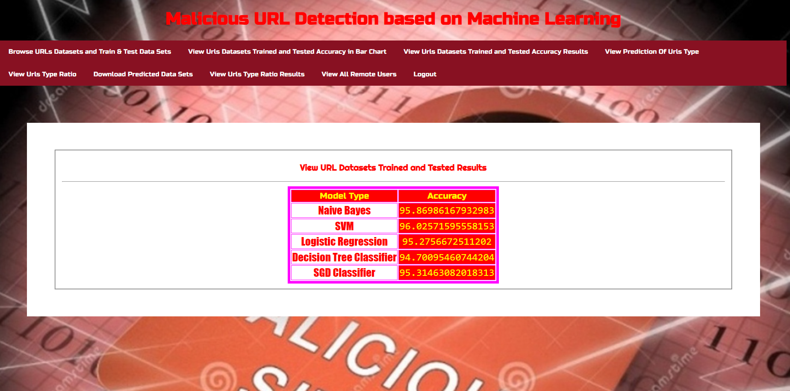
RESULTS

Slide 23
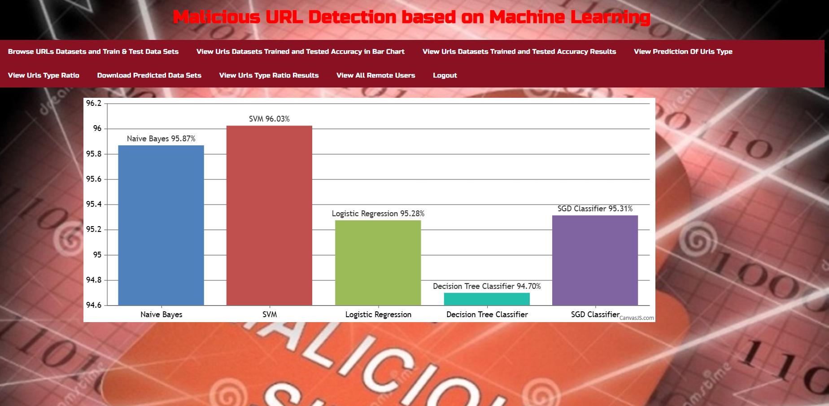
RESULTS

Slide 24
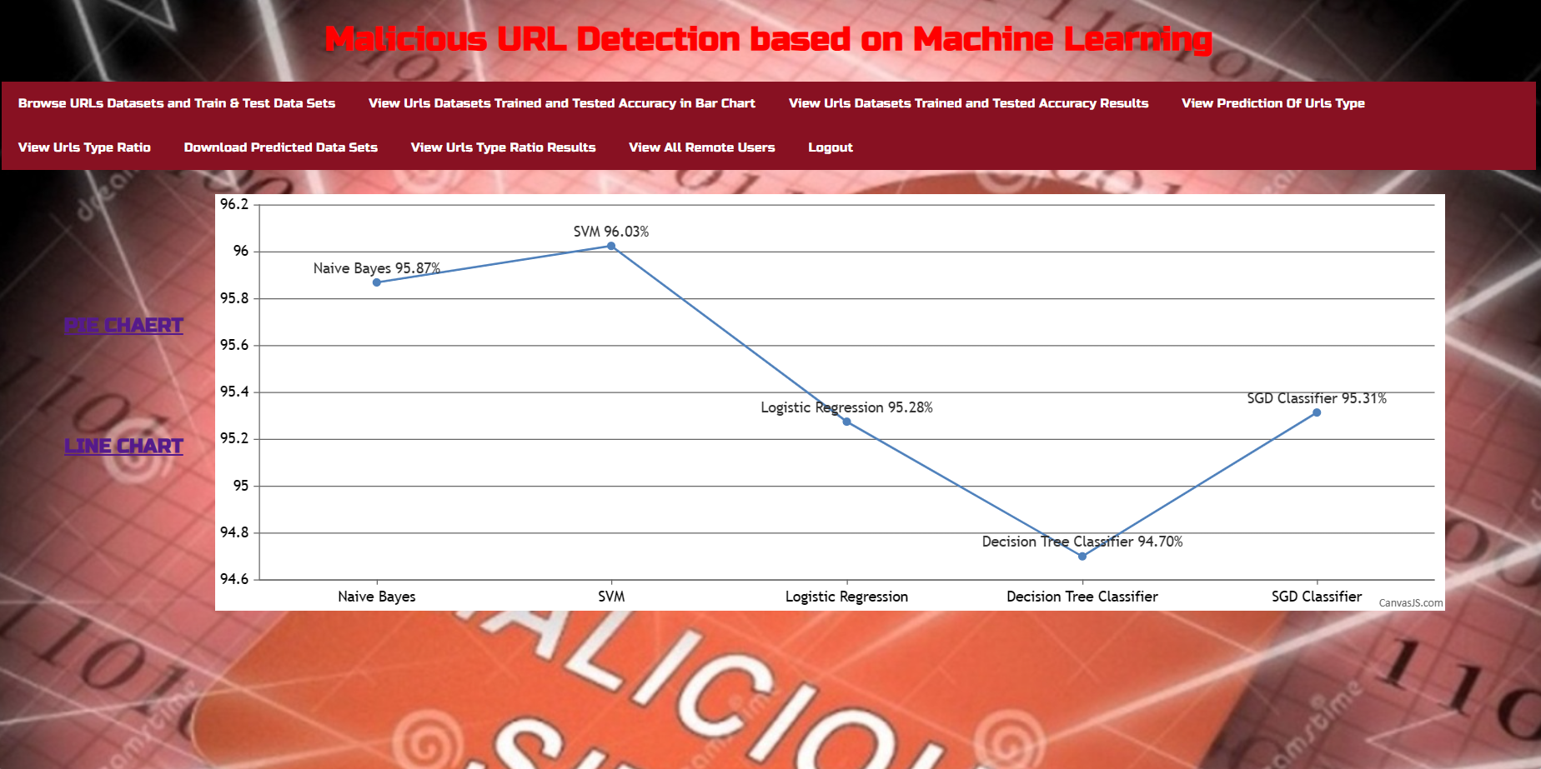
RESULTS

Slide 25
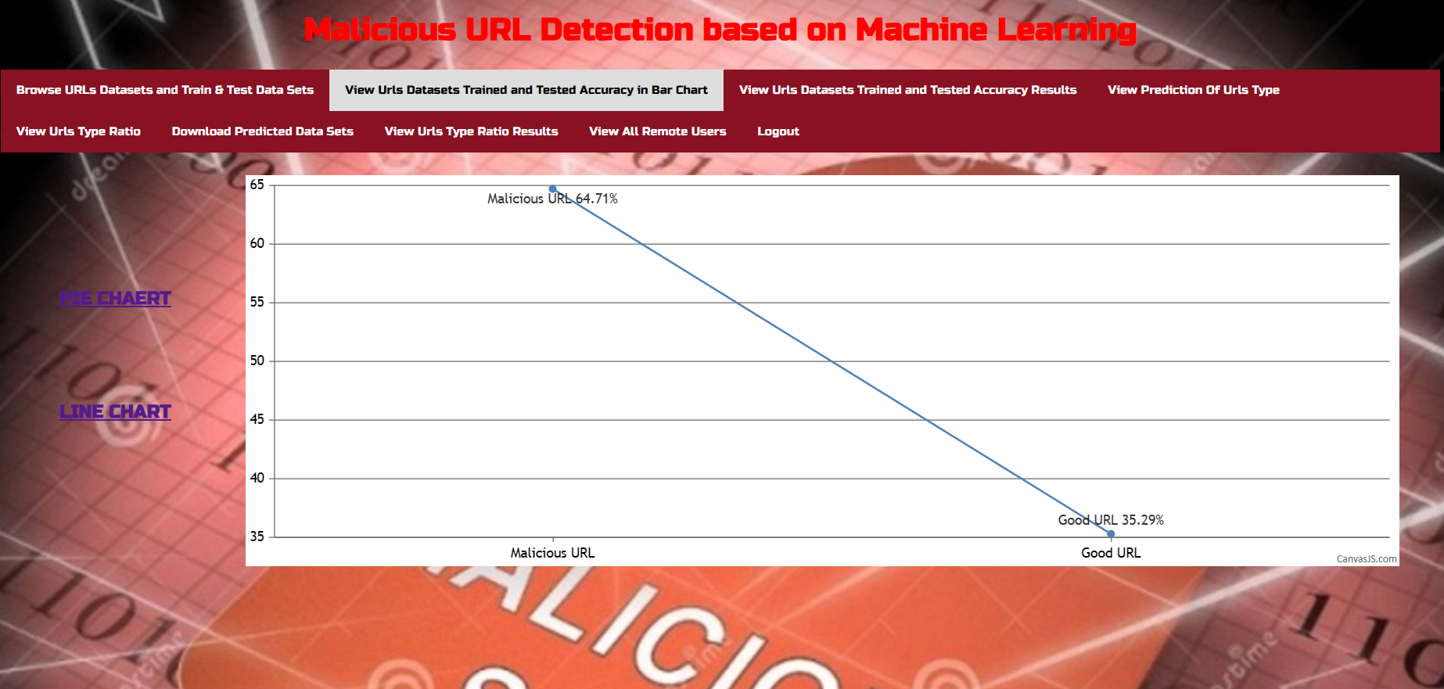
RESULTS

Slide 26
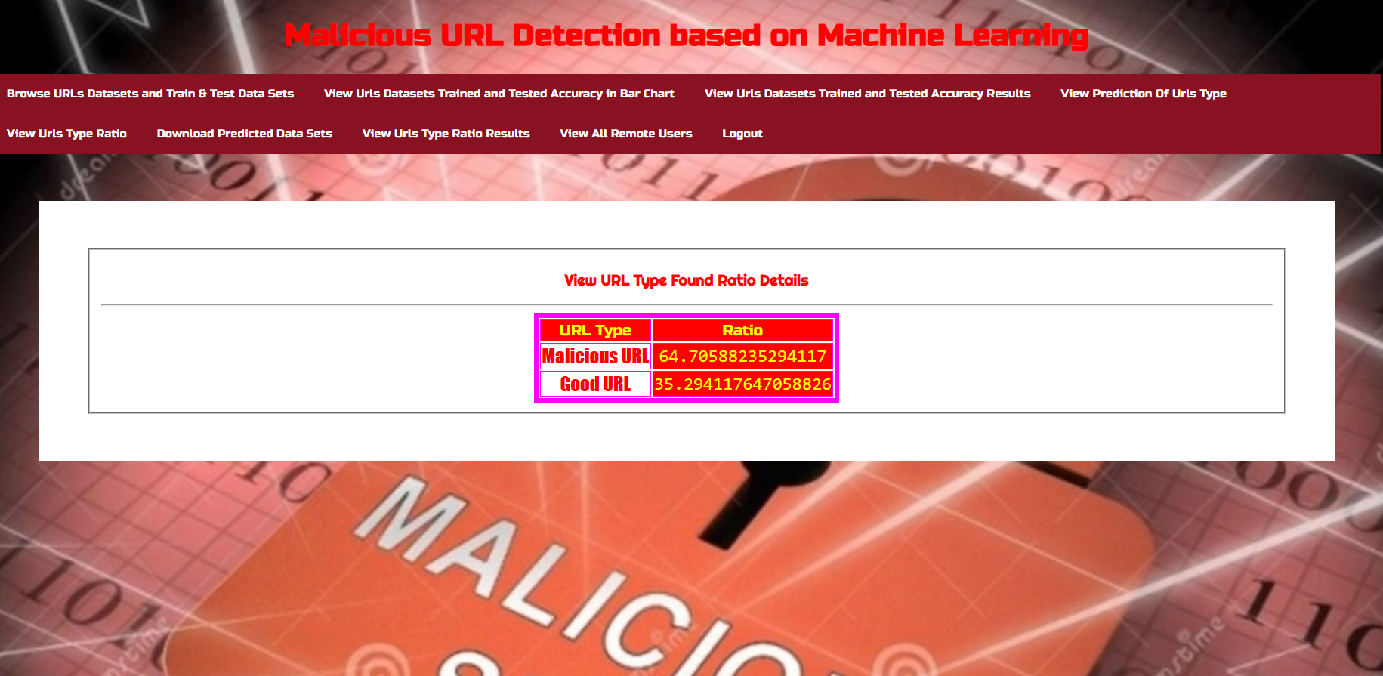
RESULTS

Slide 27
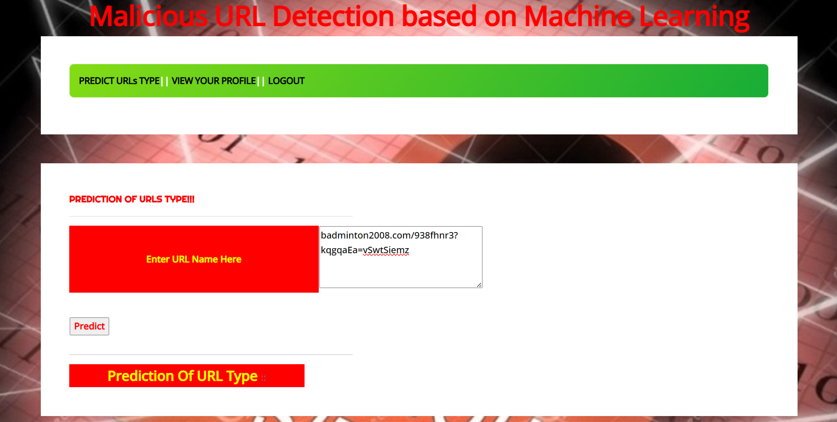
RESULTS

Slide 28
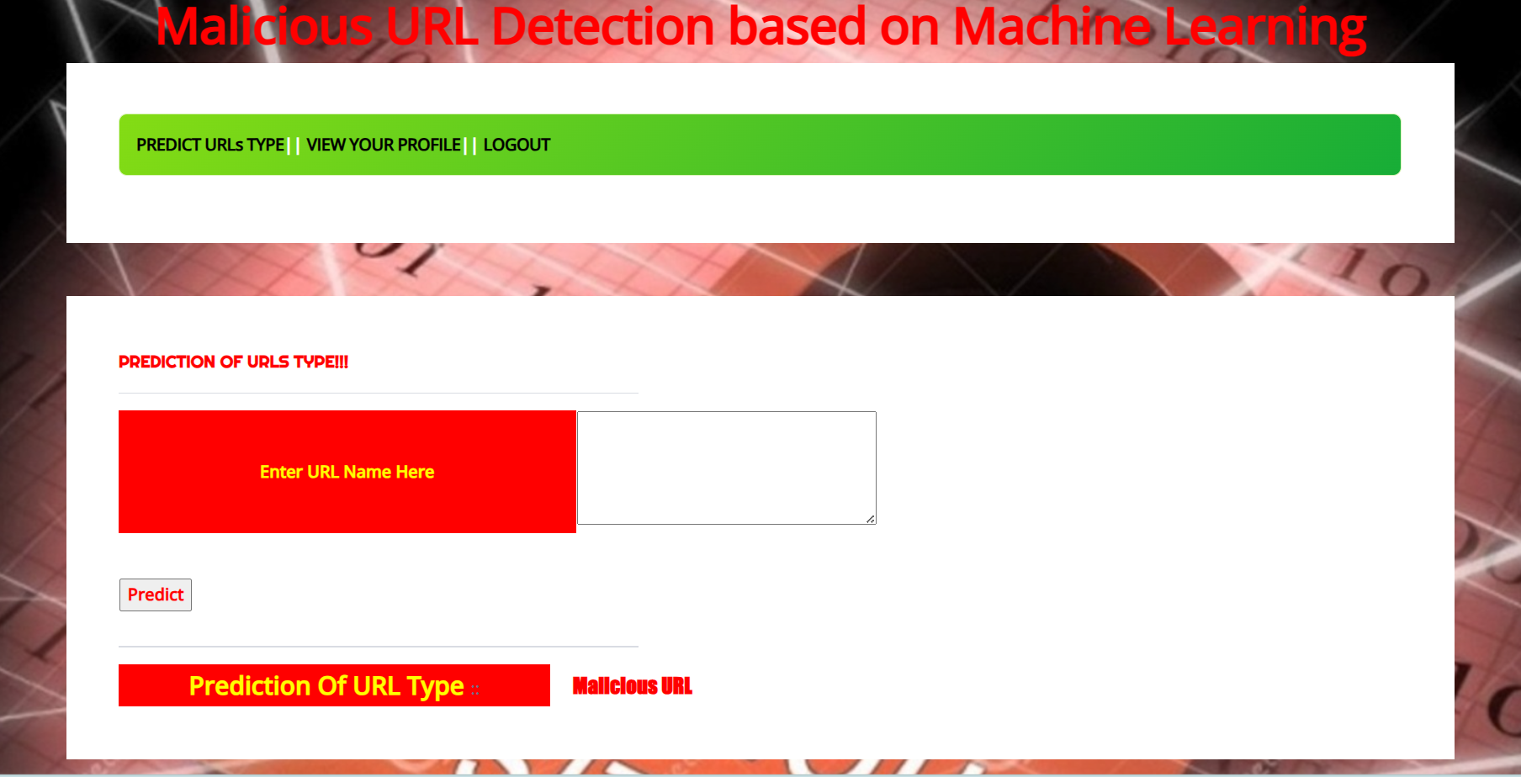
RESULTS

Slide 29
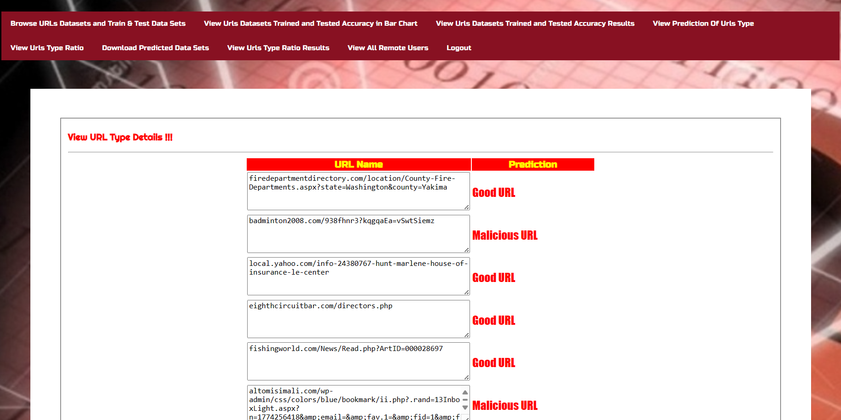
RESULTS

Slide 30
CONCLUSION
In conclusion, a Malicious URL Detection System based on machine learning represents a cutting-edge and proactive approach to fortifying web servers and service providers against evolving cyber threats.
By leveraging advanced algorithms and data analysis techniques, this system stands as a robust line of defense, capable of swiftly and accurately identifying potentially harmful URLs.
The integration of user-friendly features, such as browsing datasets, viewing accuracy results, and accessing user profiles, ensures not only the effectiveness of the system but also a seamless and intuitive experience for users.
The ability to predict URL types in real-time, coupled with the comprehensive analysis of accuracy results and type ratios, empowers users with valuable insights into the threat landscape.

Slide 31
THANK YOU

